Slide 1
CSCC01 Final Presentation
Algo Assassins
Group members: Jerry Dang, Eric Kweon, Ethan Chan, Kenny Chen, Henry Tran, Aliel J. Roxas, Jeremy Cheng
Notes:
Everyone

Slide 2
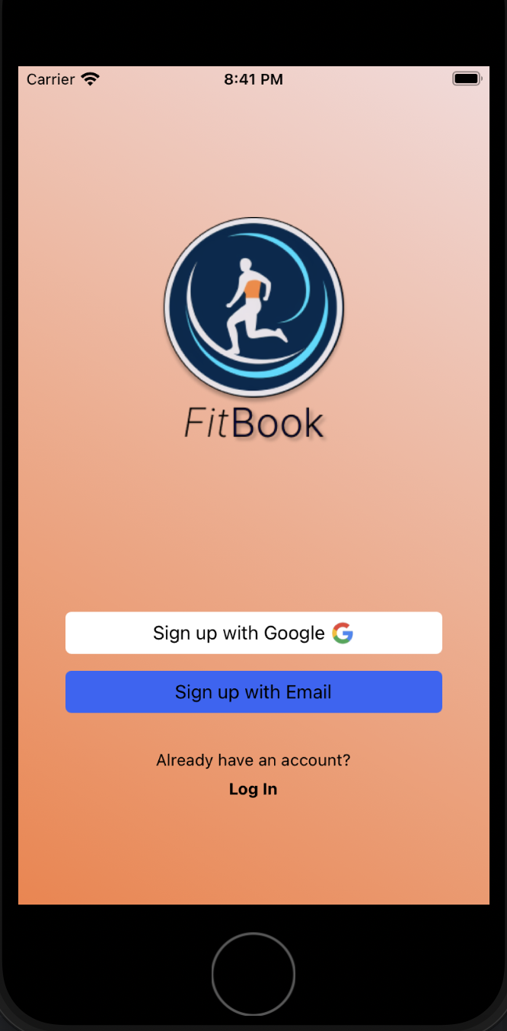


Introduction
In today's digital world, maintaining fitness can be challenging due to waning motivation.
Enter Fitbook - a blend of fitness tracking and social networking for those keen on
health and wellness.
It's a dedicated space for showcasing fitness achievements, engaging with fitness content, and enjoying a supportive community that fosters healthy competition and encouragement.
Notes:
Kenny

Slide 3
DEMO

Slide 4
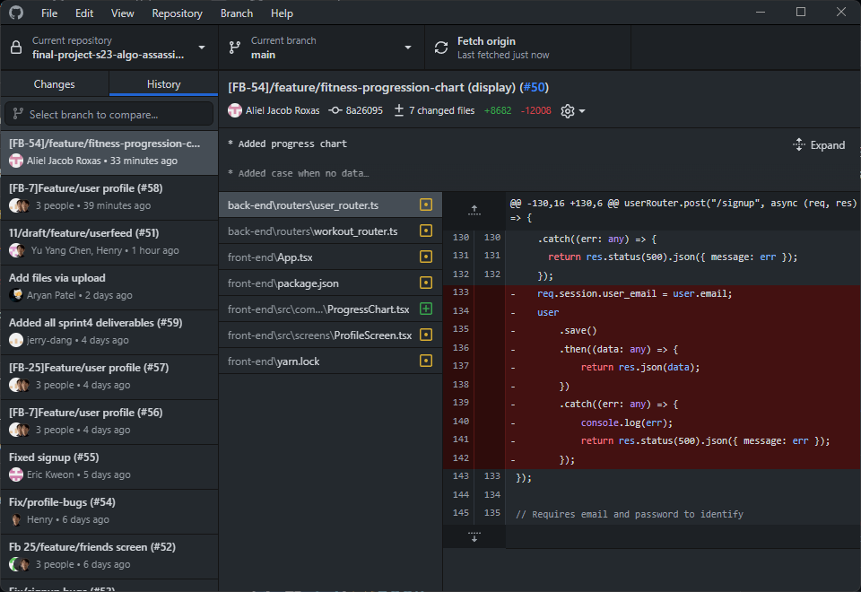
Process
Task Division:
Based on people’s wants, expertise, and amount of time for user stories.
Git Flow:
Stable branch for release in main
Sub-branches for each feature, which are merged into main via pull requests.
Format: [ticket number]/branch_name
Pull Requests:
Format: [ticket number]/branch_name
Includes description, type of change, visual aids
Can be reviewed by any team member
Front or back end team leader must approve merge before creator can merge into main
Notes:
Eric

Slide 5
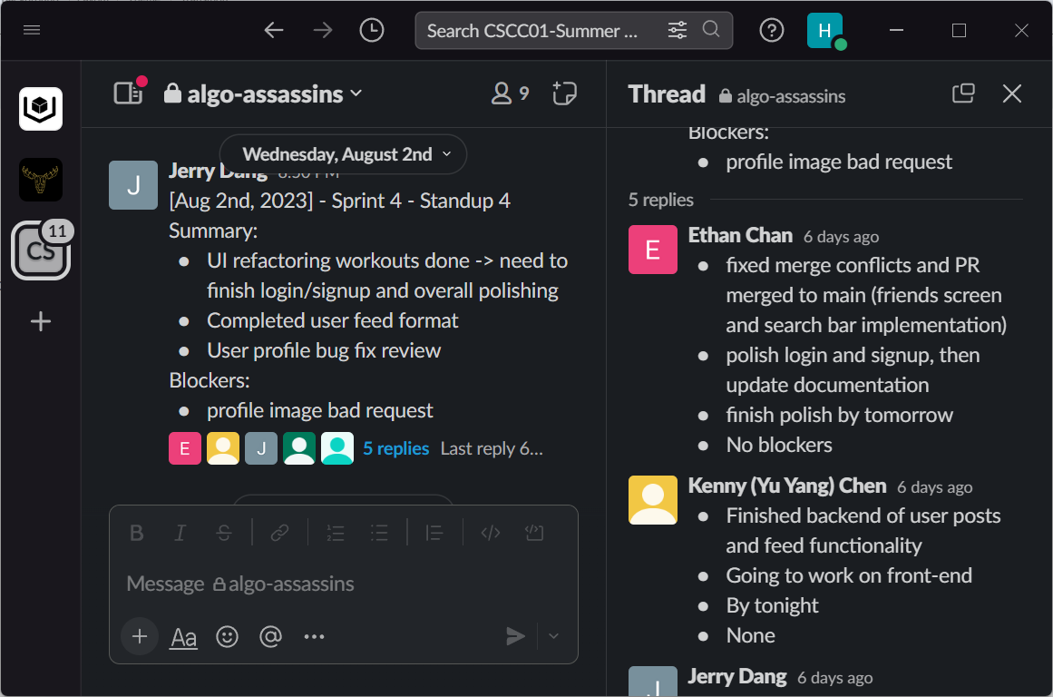
Process contd.
Communication:
Meetings held on Slack, summaries posted in Slack channel
Sprint Reviews:
Online at end of each sprint
Review velocity of team
Reevaluate story points for balanced distribution of tasks
Propose any changes in approach that would improve team’s efficiency
Standups:
Online and Asynchronous
3 online sessions and 2 asynchronous sessions per week
Review individual progress, tasks intended to complete
Address any challenges/blockers
Notes:
Ethan

Slide 6
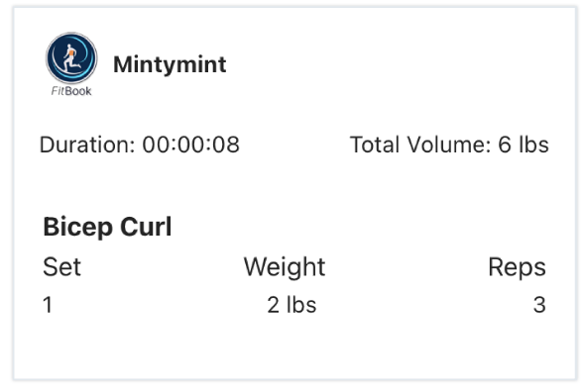
Process contd.
Significant Decisions:
Posts
Initial idea was to have posts contain an image, likes, and comments
Switched to posting workouts
Differentiates us from other social media apps like Instagram, FaceBook
Creation of PR Channel
Dedicated Slack channel for pull requests and merge conflicts
Easier sharing of screenshots, discussing code changes, and engaging in voice chats
Improved coordination and communication
Notes:
Ethan

Slide 7

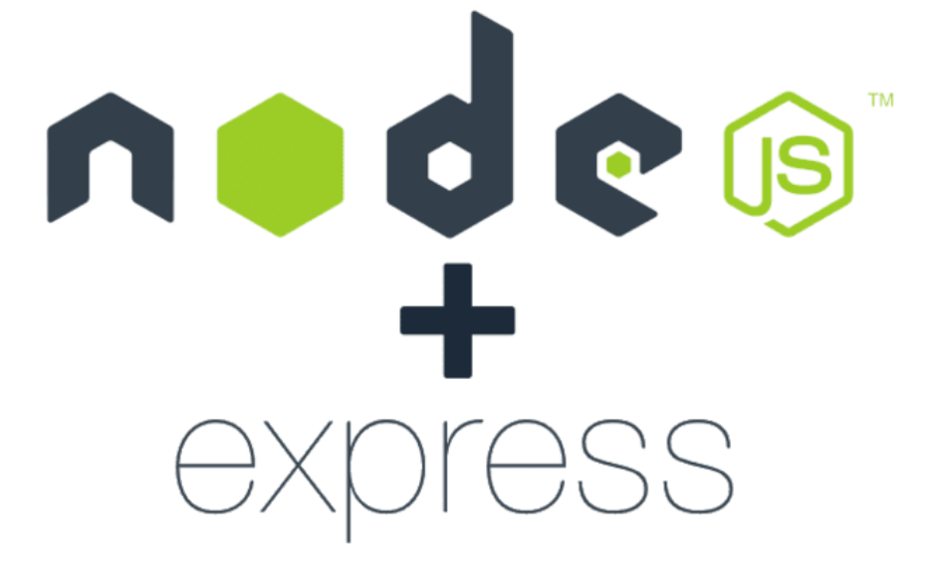



Technical
React-native
MongoDB
Typescript
Express.js
IOS & Android
Notes:
Aliel

Slide 8
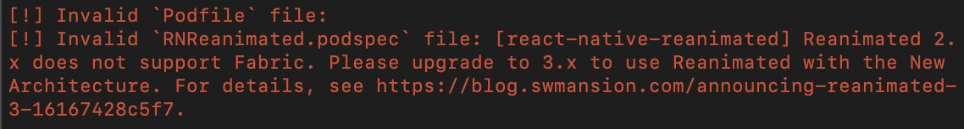
Technical
React-native-simple-toast
Compatibility issue with react-native-reanimated version 2.x
Error messages: CompileC /Users/user/Library/Developer/Xcode/DerivedData/BinBuddy-easgtqwgvhpqvoborkrbeezjoopp/Build/Intermediates.noindex/Pods.build/Debug-iphonesimulator/react-native-simple-toast.build/Objects-normal/arm64/RNSimpleToast.o /Users/user/Documents/CSCC01/final-project-s23-algo-assassins/front-end/node_modules/react-native-simple-toast/ios/RNSimpleToast.mm normal arm64 objective-c++ com.apple.compilers.llvm.clang.1_0.compiler (in target 'react-native-simple-toast' from project 'Pods') (1 failure)
Notes:
Aliel

Slide 9
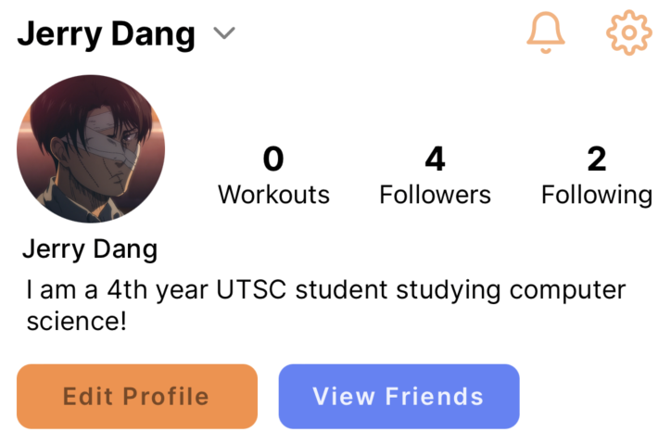
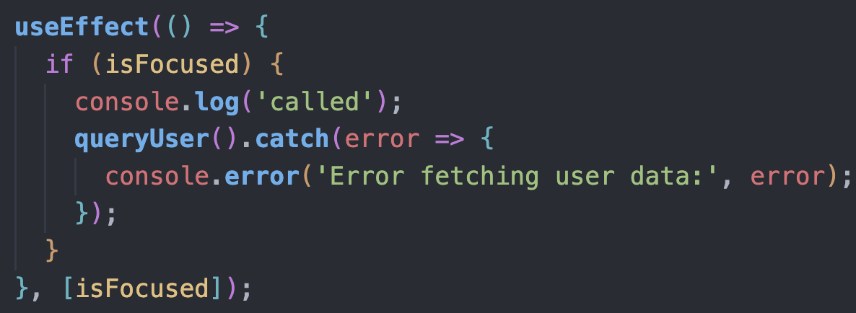
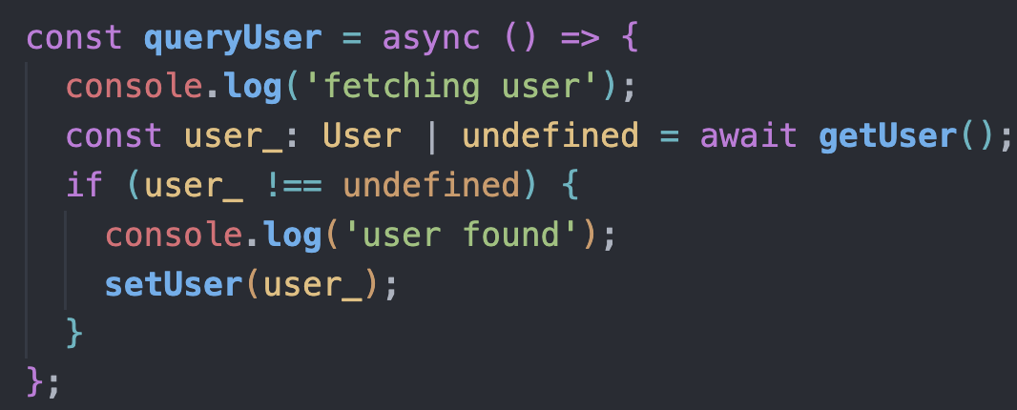
Technical
User profile information rendering
Issue: information not rendering updated information immediately after user edits their profile
Solution: useEffect() and queryUser() function and user methods defined in user.ts in utils folder in the backend
Notes:
Jerry

Slide 10
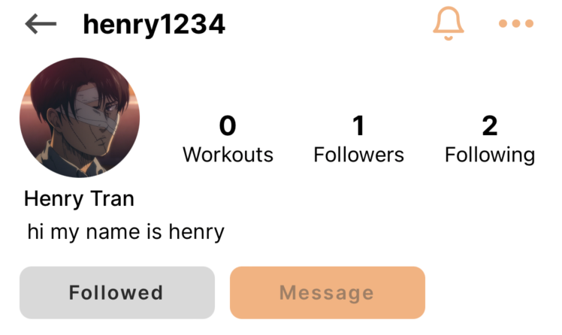
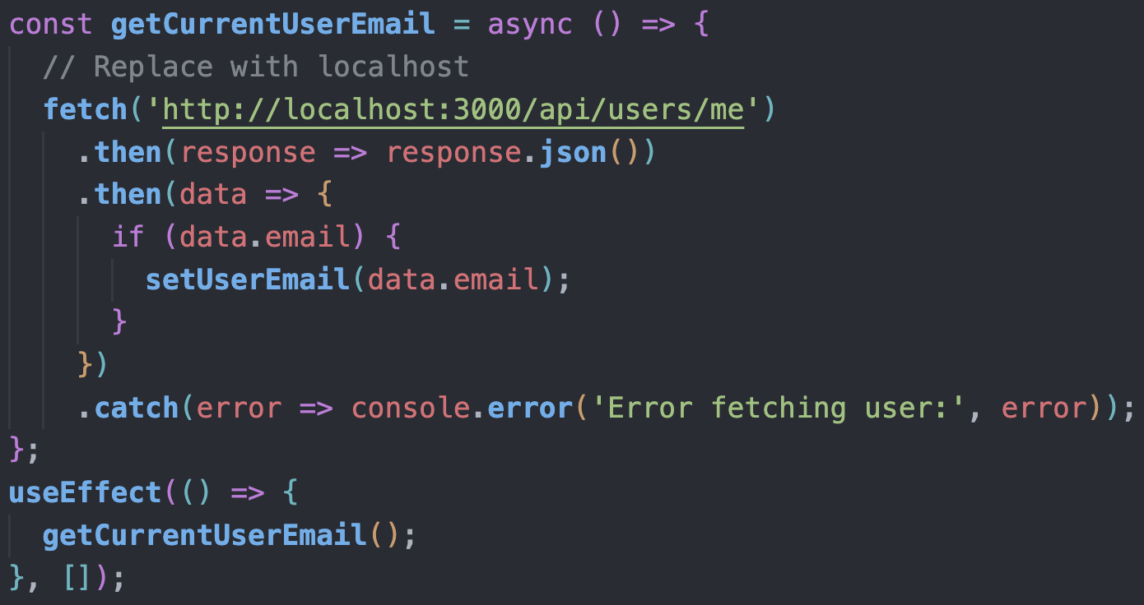
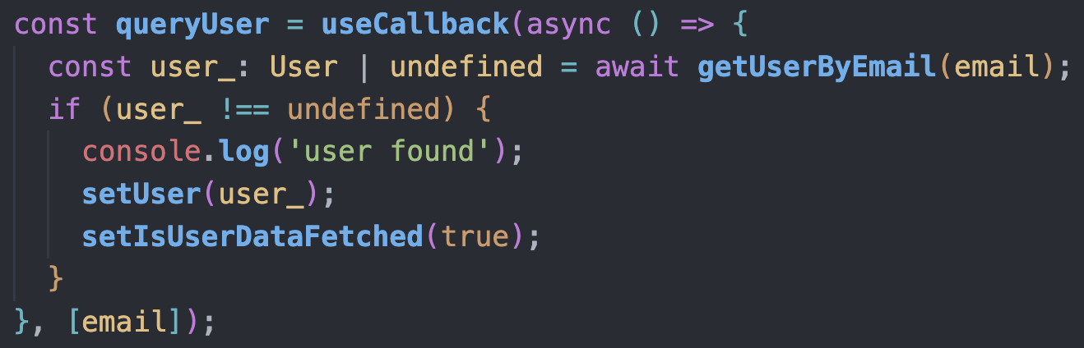
Technical
Other users other than the current user
Notes:
Jerry

Slide 11
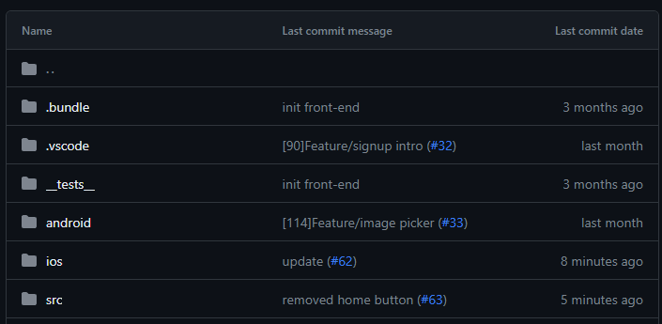
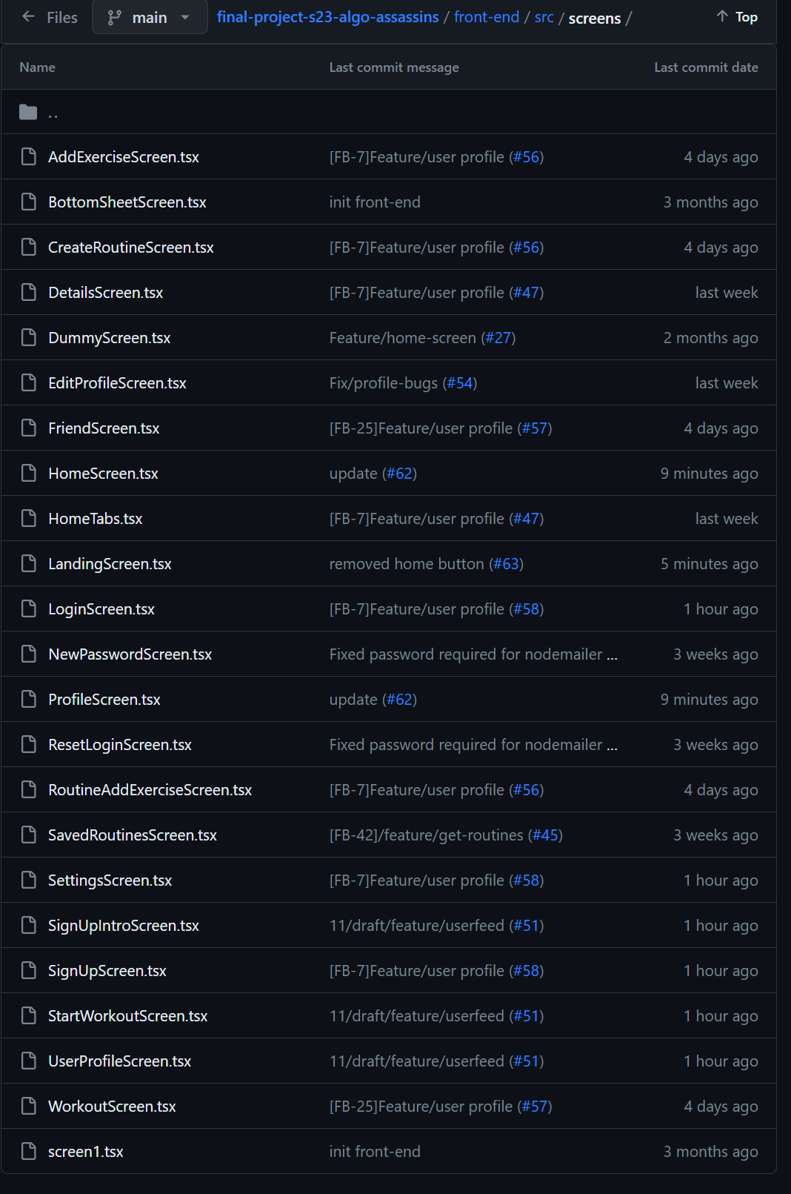
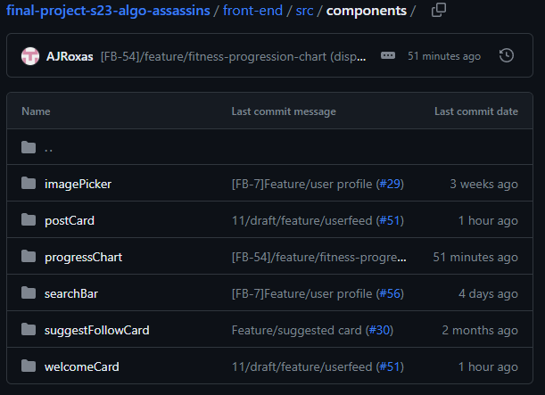
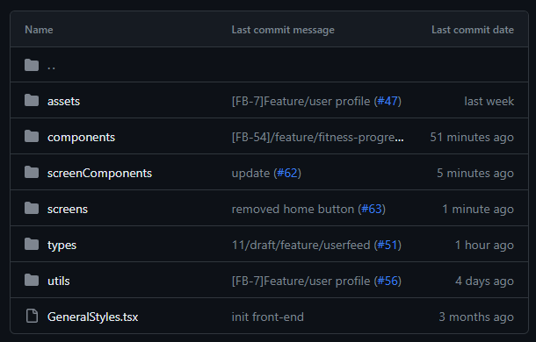
Project Code
Notes:
Henry
Our frontend repo is based on react-native architecture, and we have a primary src folder with subfolders for, assets, components, screens, types, utils and styles. Each section has their uses and we wanted to do it this way in order to keep everything organised. You can also see we have some of our screens and components that we used to build our app on the right. But yeah that’s it for our frontend and we can move onto the backend.

Slide 12
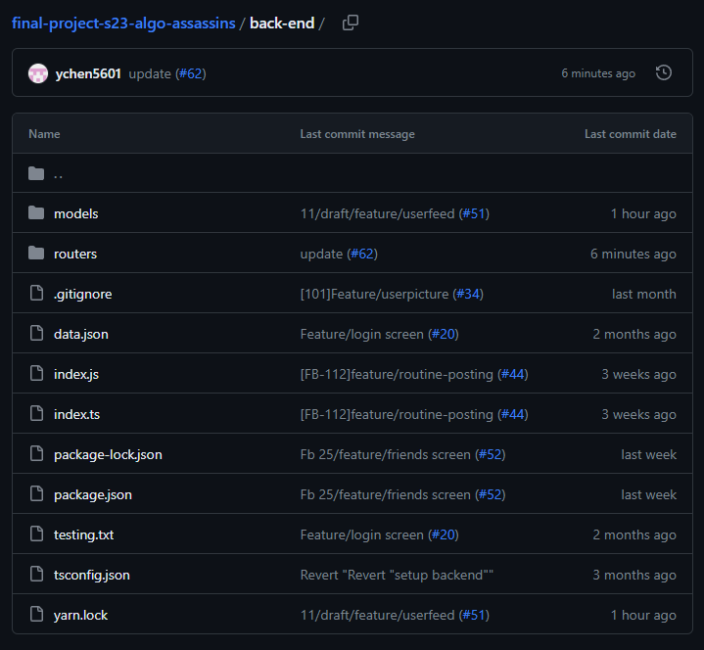
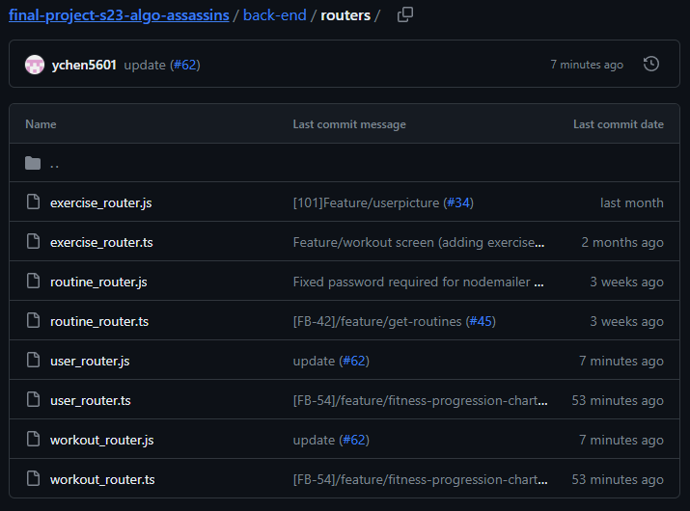
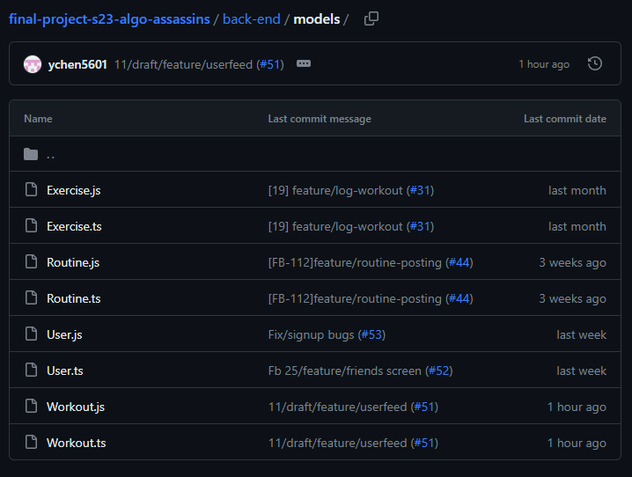
Notes:
Jeremy

Slide 13
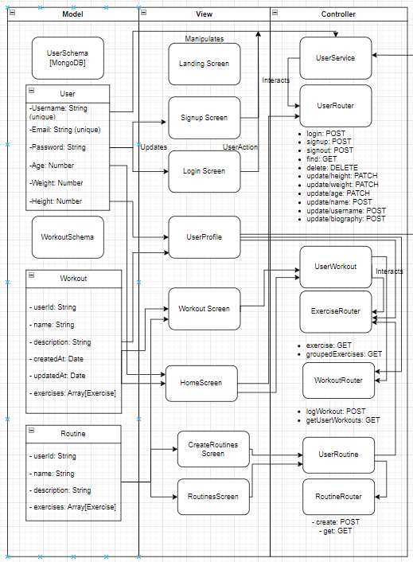
Model View Controller

Slide 14
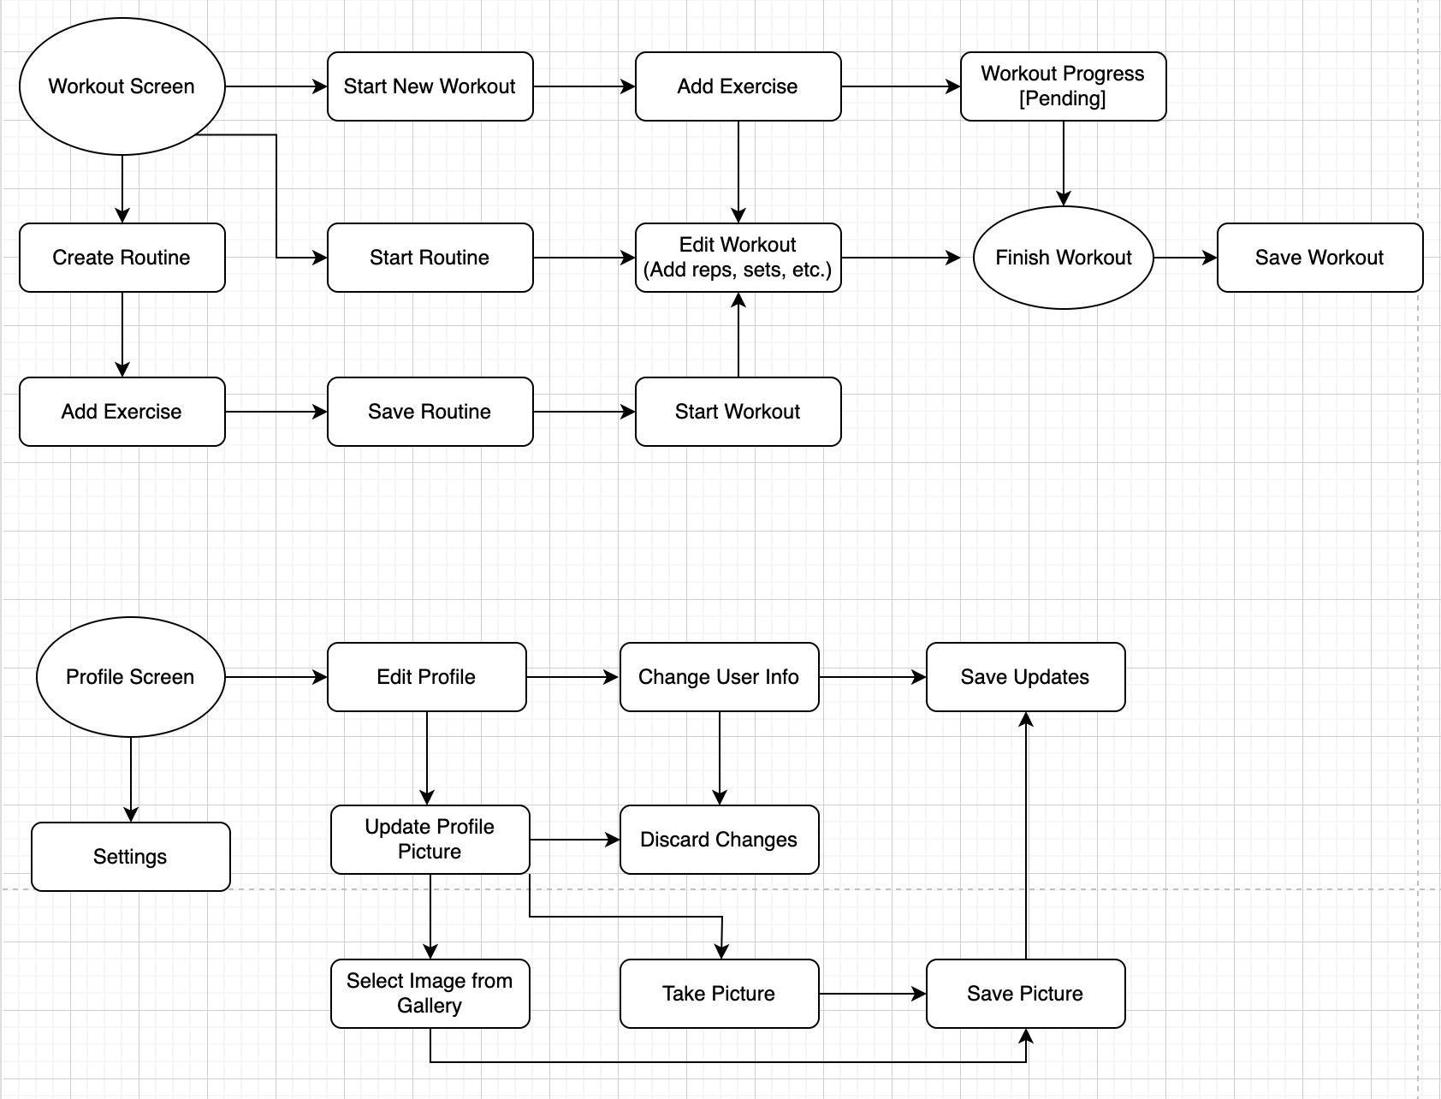
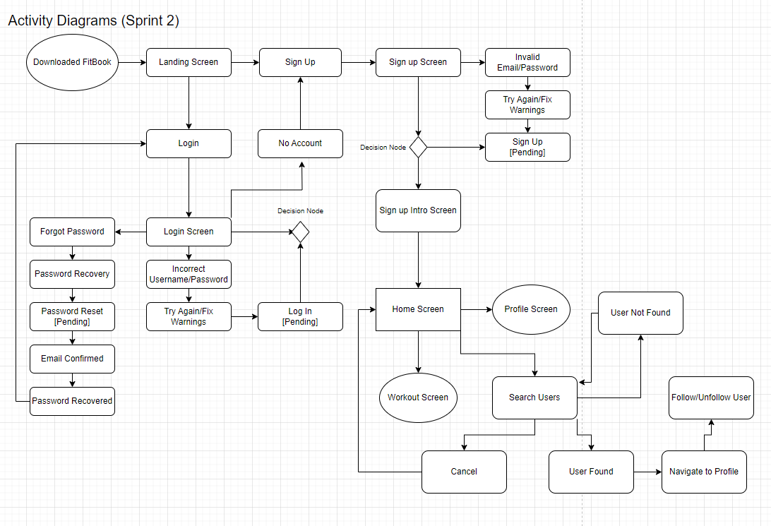
Activity Diagrams
Notes:
Jerry

Slide 15
Individual Contributions
Notes:
Everyone goes through their contributions

Slide 16
The End
Any Questions?
Notes:
Everyone

